Slide 1
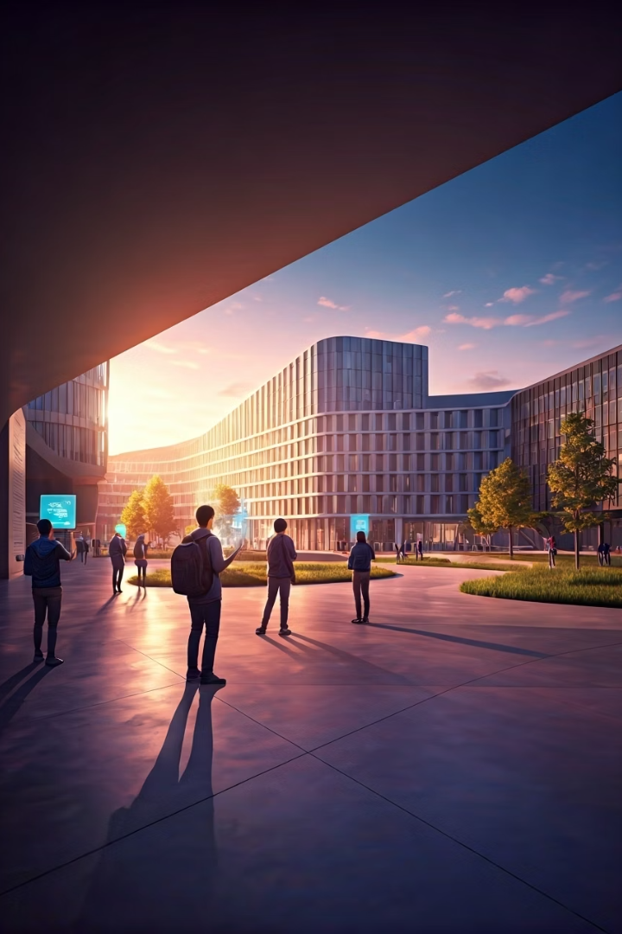
ALTIS: A Virtual Campus Solution
Welcome to the future of higher education. ALTIS, the AIR Learning & Training Information System, revolutionizes campus management. It creates a seamless digital experience for students, faculty, and administrators.
by
241908 - Haseeb Jalil
241839 – Taimur Sajid

Slide 2




Overview of ALTIS
Centralized Platform
Seamless Interaction
Enhanced Learning
A unified hub for all academic activities.
Connecting students, faculty, and administration.
Supporting digital education initiatives.
ALTIS is designed to streamline digital education. It provides a comprehensive, centralized system for all university operations. This platform fosters seamless interaction across all user roles.

Slide 3
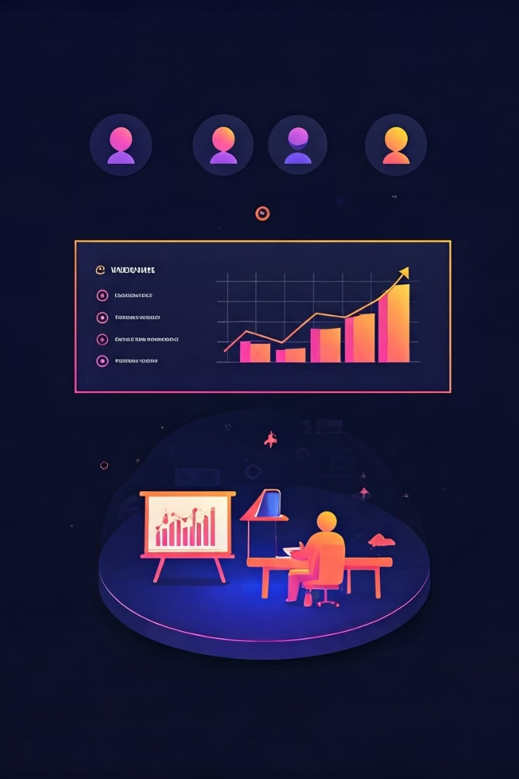



ALTIS: The Comprehensive Solution
Centralized Portal
Single point of access for all university functions.
Multiple User Roles
Tailored experiences for administrators, faculty, and students.
Digital Classrooms
Virtual spaces for lectures, discussions, and collaboration.
ALTIS solves these issues with a centralized portal for all users. It supports diverse roles, from administrators to students. The system also integrates digital classrooms, enhancing the learning environment.

Slide 4
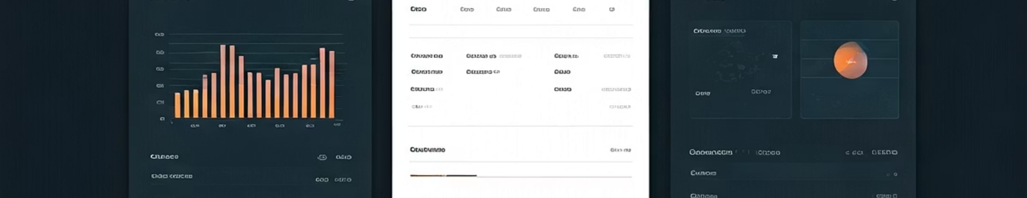
Core System Modules
1
Admin Portal
2
Faculty Portal
3
Student Portal
Manages student and faculty data, handles result processing efficiently.
Enables classroom creation, attendance tracking, assignments, and announcements.
Provides class access, assignment submission, result viewing, and announcements interaction.
ALTIS comprises three key portals: Admin, Faculty, and Student. Each portal offers tailored functionalities. This ensures efficient management and a user-friendly experience for everyone.

Slide 5

Robust Technology Stack
Backend
ASP.NET Core, SQL Server
Frontend
HTML/CSS/JavaScript, Windows Forms
Development Tools
Visual Studio, NuGet Packages
ALTIS is built on a strong technical foundation. The backend uses ASP.NET Core and SQL Server for robust data management. The frontend employs modern web technologies or Windows Forms for flexible interfaces.

Slide 6

Key Features for Enhanced Security & Access
Authentication
Secure user login and identity verification.
Data Security
Encryption and protection of sensitive information.
Role-Based Access
Granular permissions based on user roles.
Responsive Interface
Optimized for various devices and screen sizes.
ALTIS prioritizes security and accessibility. Features like robust authentication and role-based access control ensure data integrity. A responsive interface guarantees seamless use across all devices.

Slide 7






Future Scope & Impact
ALTIS will continue to evolve, integrating advanced features for a truly dynamic campus environment.
Student Chats
Real-time communication and collaboration tools.
Online Exams
Secure and efficient digital assessments.
Online Meetings
Zoom-like Online Class Meetings
The future of ALTIS includes online exams, integrated student chat, and meetings. These enhancements will further empower Air University. ALTIS delivers significant value to institutions, streamlining operations and enriching the educational journey.

